Slide 1
Acceleration

Slide 2
By the end of the lesson, you should be able to:
Define acceleration.
State the formula for calculating acceleration.
Calculate acceleration.

Slide 3
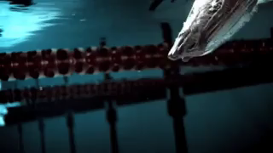
Acceleration is a change in an object's velocity over time.
Remember, velocity is very similar to speed, but it acts in a certain direction.
This means that an object accelerates when it speeds up, slows down or changes direction.

Slide 4


When an object's velocity changes, we say that it is accelerating.
Acceleration (a) is the change in velocity (Δv) over the change in time (Δt).
We use this formula to find an object's acceleration:

Slide 5

Calculating change in velocity
The change in velocity (Δv) is found by subtracting the initial velocity (u) from the final velocity (v).
Δv=v−u
This means we can also write the formula for acceleration as:

Slide 6

Acceleration can have either a positive or negative value.
This is determined by the direction of motion, because acceleration is a vector quantity.
The direction depends on two things: whether velocity is increasing or decreasing, and whether the object is moving in a positive or negative direction.

Slide 7
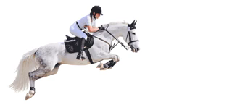
If an object is speeding up in a positive direction, it has a positive acceleration.
This is because the final velocity is greater than the initial velocity, so there is a positive change in velocity.

Slide 8
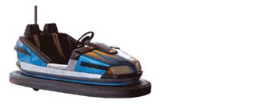
If an object is slowing down in a positive direction, it has a negative acceleration.
Acceleration is acting in the opposite direction to velocity.
This is because the final velocity is less than the initial velocity, so there is a negative change in velocity.

Slide 9

Acceleration has the unit metres per second squared.
This is written as m/s² or ms^{−2.}

